Slide 1
Human Biology.
Biology is derived from the Greek word/bios/meaning/life and logos/meaning/study/and is defined as the science of life and living organisms. An organisms is a living entity consisting of one cell e.g. bacteria, or several cells e.g. animals, plans and fungi.
Aspect of biological science range from the study of molecular mechanisms in cells, to the classification and behaviour of organisms, how species evolve and interaction between ecosystems.
Level of Living Organisms.
1. Atom
2. Molecule
3. Cell
4. Tissue
5.Organ
6.Organ System
7.Organizem
8.Populate
9. Community
10. Biosphere.(Echosystem)
This Photo by Unknown Author is licensed under CC BY-SA

Slide 2
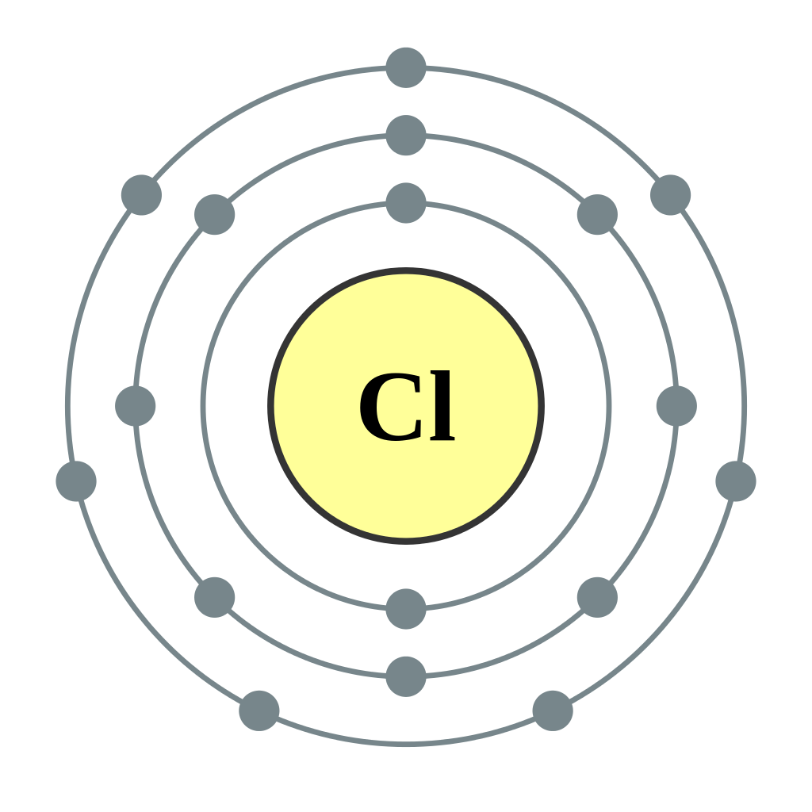
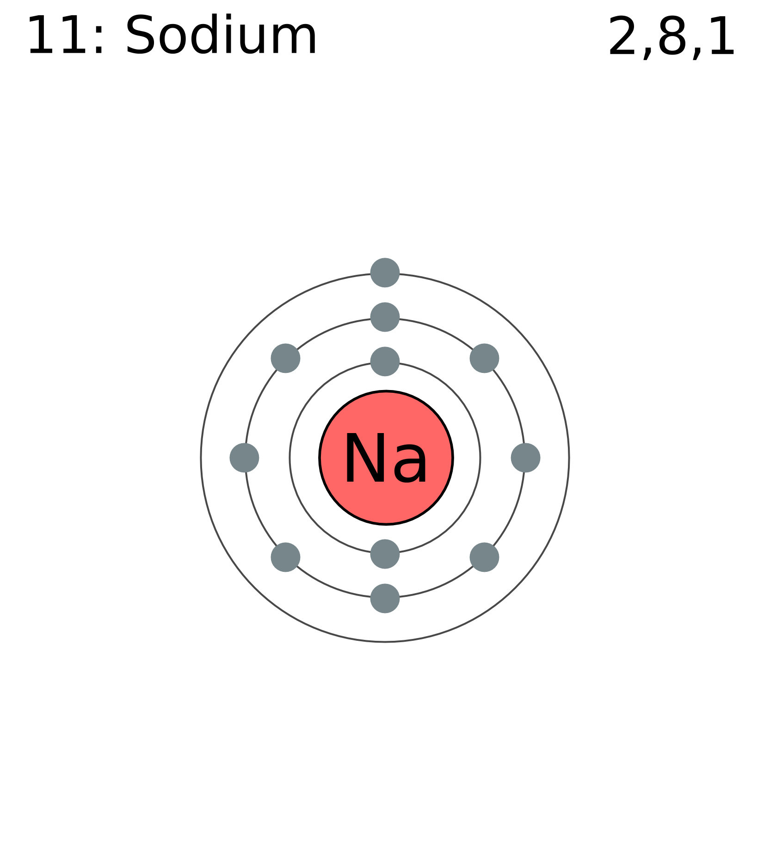
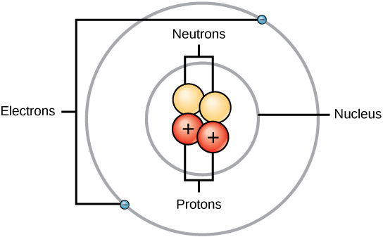
1. Atom
Atom Is an Element
Atom is the smallest unit that has all the characteristic of the Element.
Atom is neutral. The number of proton is equal to the number of electron.
Atomic number is the number of protons only.
Atom mass is the number of protons + number of neutrons.
Nucleus structure has a positive proton and a neutral neutrons. Electron is a negative charged particle.
Cl is the name of Chlorine Atom and has all the characteristic of the chlorine
Na is the name of the Sodium Atom and has all characteristic of the sodium

Slide 3
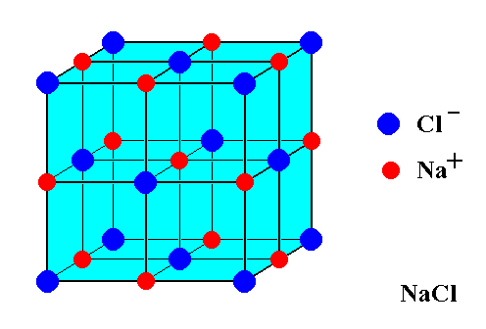
2. Molecule
Groups of Atoms are Molecules
The most Important Biomolecules in human body are 4.
a) Carbohydrates b) Lipids
c) Protein d) Nucleic acid
NACL Sodium Chloride formula

Slide 4
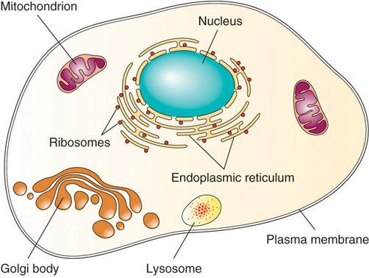
3.Cell
The nucleus of the cell is a structure in the cytoplasm that is surrounded by a membrane (the nucleus membrane) and contains, and protects most of the cell’s DNA.
Characteristics of Life
Cell is the smallest unit of Life
Energy is the form of ATP. (Adenosine Triphosphate ) is the source of energy for use and storage at the cellular level.
Sensation for Protection to be alive. (Cellular Self- Defense)
Reproduction. (To continue the life circle. (parents, children).
Homeostasis .( To keep the internal environments constant).
Evolution. (The changes over time)
There are two basic type of cells.
Prokaryotic cells. These cells are without a nucleus. The only organelles in prokaryotic cells are ribosomes. They are found in single-celled organisms such as bacteria.
Eukaryotic cell These are cells that contain a nucleus. They have other organelles besides the nucleus. They are larger then prokaryotic cells and they are found mainly in multicellular organisms. Organisms with eukaryotic cells are called eukaryotes and they range from fungi, to people.

Slide 5
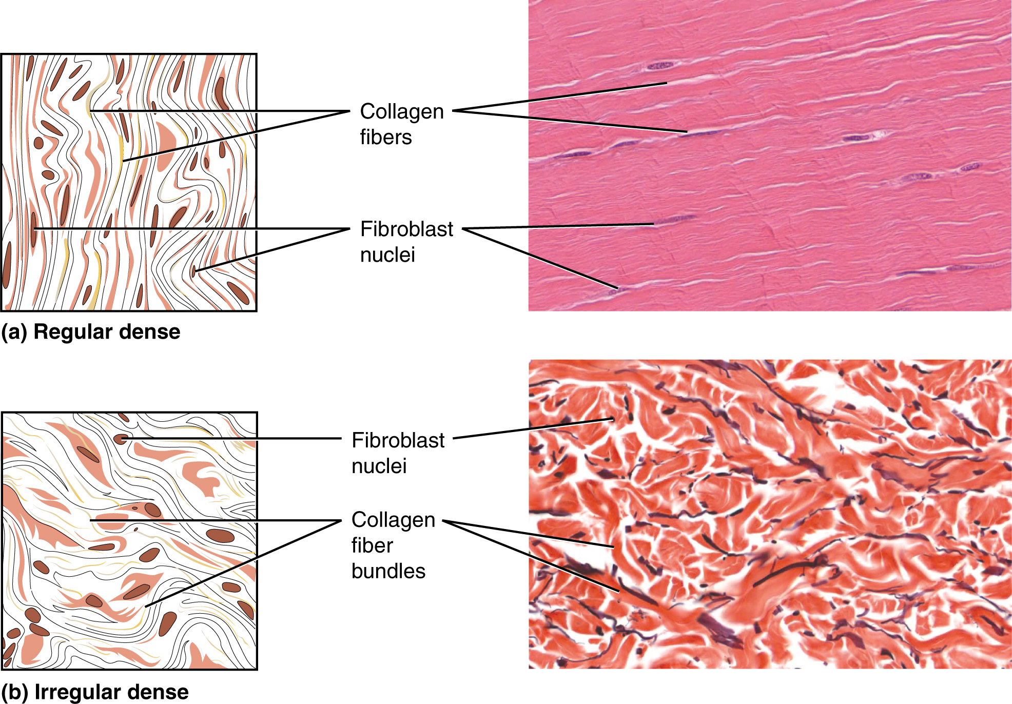
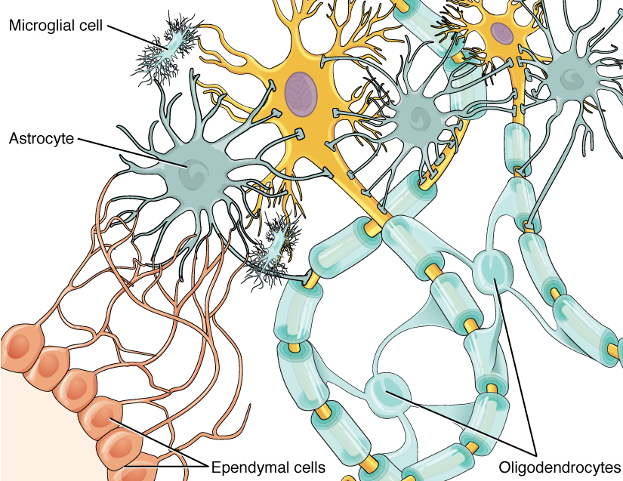
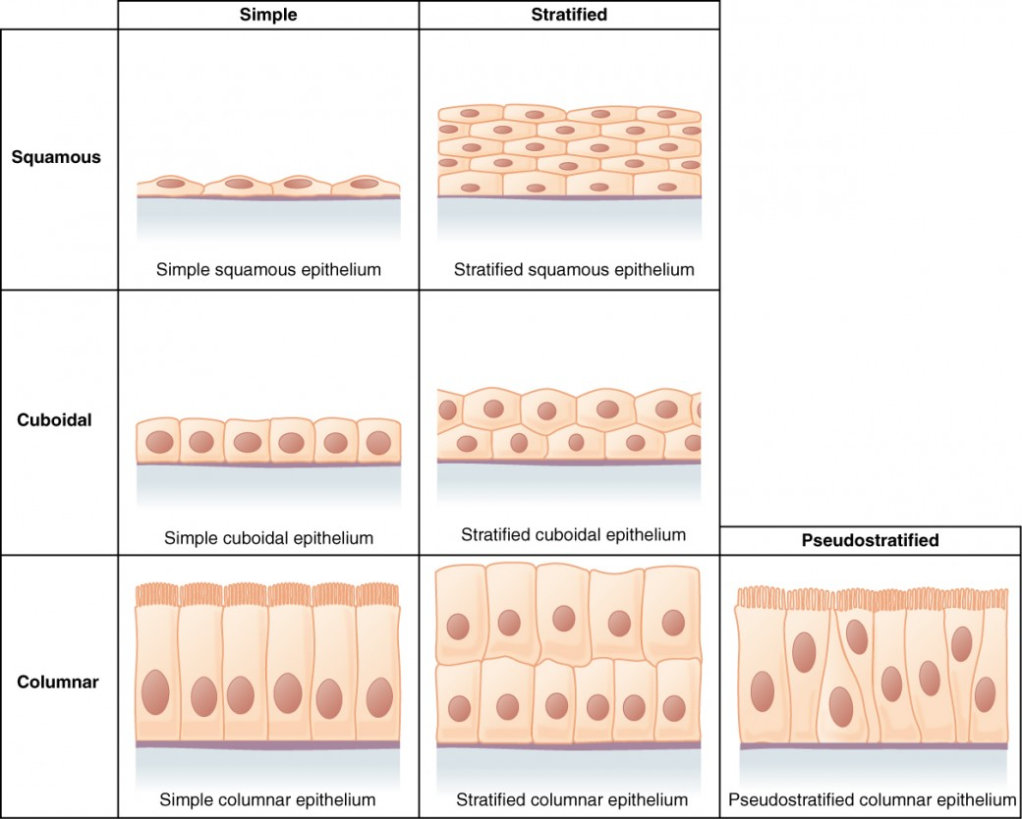
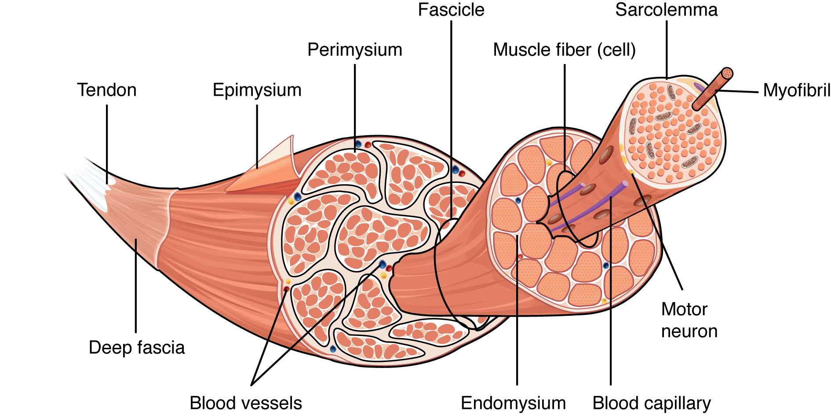
4. Tissue
Tissue is a group of Cells. There are 4 groups of Tissues . Epithelial, Connective, Nervous and Muscular Tissues.
Connective Tissue
Nervous Tissue
1.EPITHELIAL TISSUES
Muscular Tissue
This Photo by Unknown Author is licensed under CC BY-SA

Slide 6
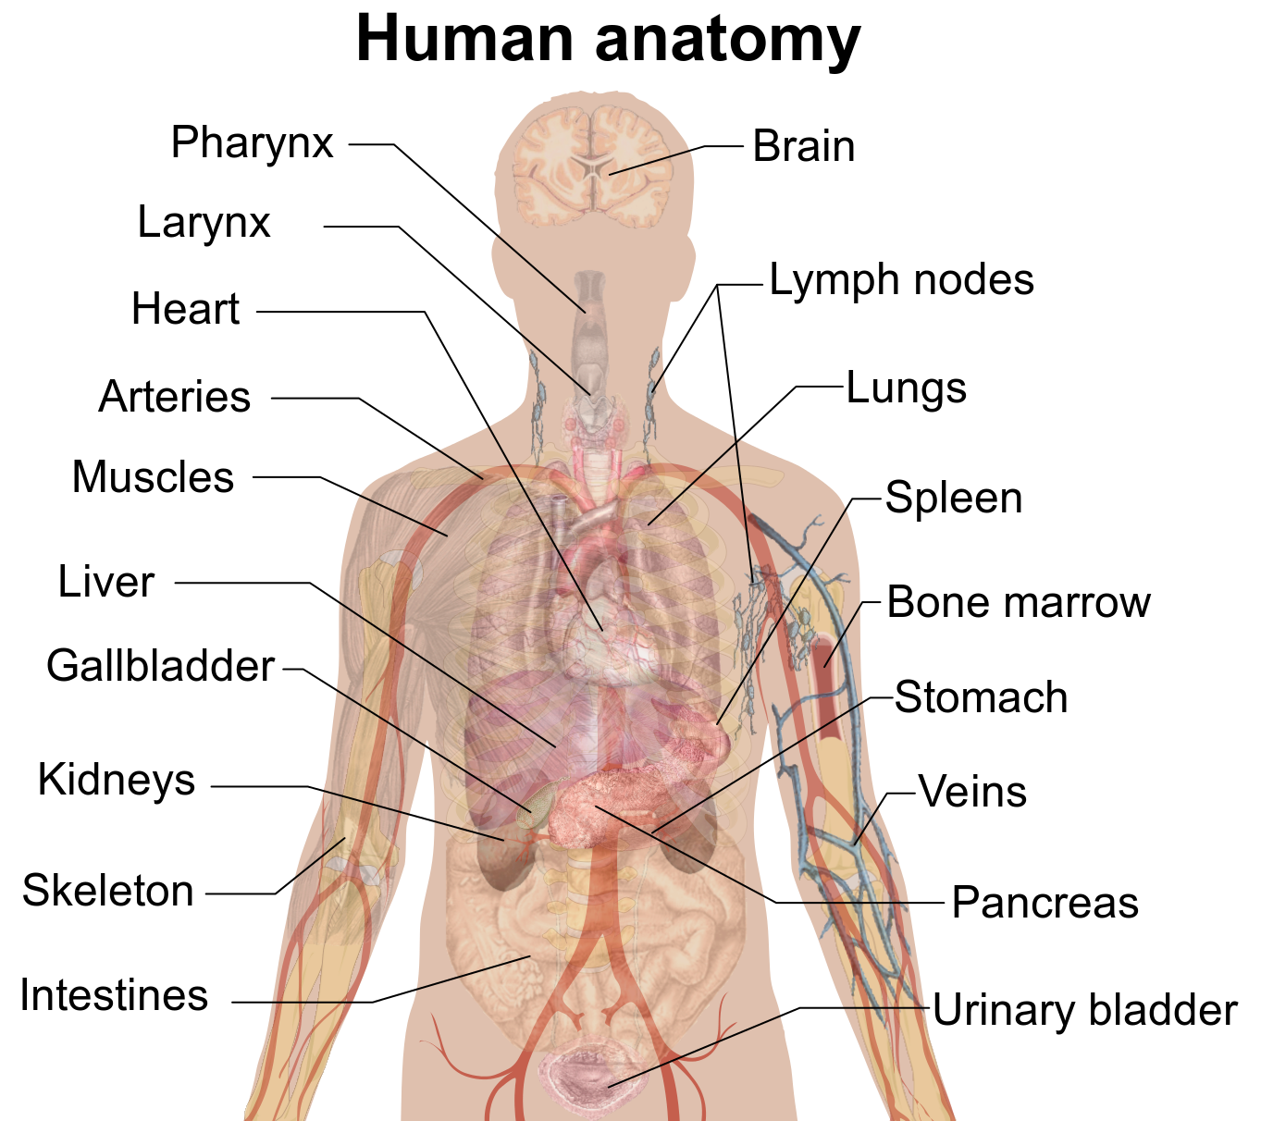
An organ is a collection of tissues joined in a structural unit to serve a common function.
Organs exist in most multicellular organisms, including not only humans and other animals but also plants. In single-celled organisms such as bacteria, the functional equivalent of an organ is an organelle
Vital Organs
The human body contains five organs that are considered vital for survival. They are the heart, brain, kidneys, liver, and lungs. The locations of these five organs and several other internal organs are shown in the picture. If any of the five vital organs stops functioning, the death of the organism is imminent without medical intervention.
The heart is located in the center of the chest, and its function is to keep blood flowing through the body. Blood carries substances to cells that they need and also carries away wastes from cells.
The brain is located in the head and functions as the body’s control center.
It is the seat of all thoughts, memories, perceptions, and feelings.
The two kidneys are located in the back of the abdomen on either side of the body. Their function is to filter blood and form urine which is excreted from the body.
The liver is located on the right side of the abdomen. It has many functions including filtering blood, secreting. Bile that is needed for digestion, and producing proteins necessary for Blood clotting.
The two lungs are located on either side of the upper chest. Their main function is exchanging oxygen and carbon dioxide with the blood.
Human Organs

Slide 7
Human Organ Systems
1.Integumentary System
2.Skeletal System
3.Muscular System
4.Nervous System
5.Endocrine System
6.Cardiovascular System
7. Urinary System
8.Respiratory System
9.Lymphatic System
10. Digestive System
11. Male & Female Reproductive Systems

Slide 8
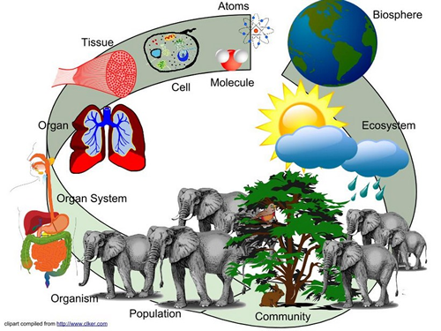
POPULATE
A group of organisms all of the same species that live in a specific area is called POPULATE.
If the area is populated by people or animals, they live in that area.
For example: The river is populated mainly by smaller species of fish.

Slide 9
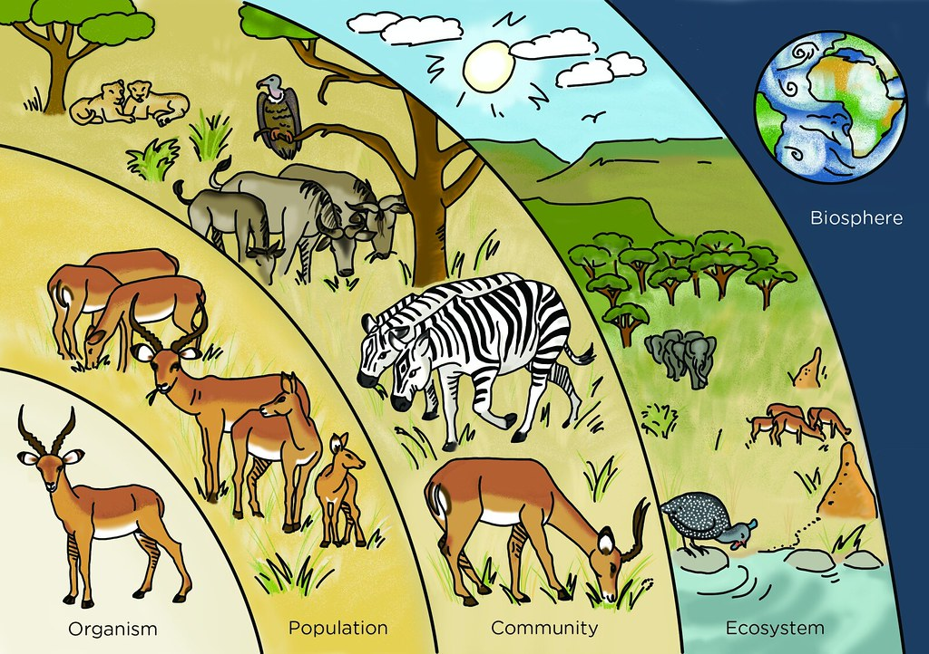
COMMUNITY
A community comprises populations of various species, and fungi that coexist in one place.

Slide 10
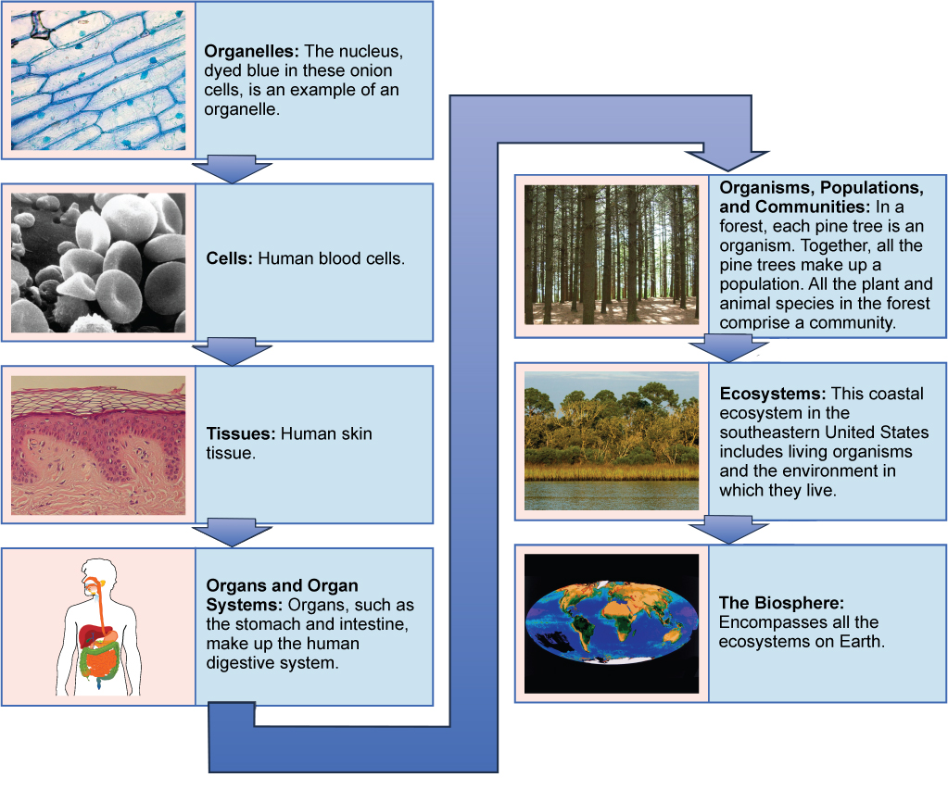
BIOSPHERE
The Biosphere is the part of the earth where living things exist.
It encompasses all living things in the lithosphere, atmosphere, and hydrosphere.
The Biosphere is the region of the earth that encompasses all living organisms; plants animals and bacteria.
Another term used for Biosphere is Ecosphere. (“eco” means home).

